Slide 1



Data, Tech & Analytics
Get into Tech Course

Slide 2

2
1
Why did I apply?
2
The GIT group
3
GIT Key Info & Modules
4
So far
5
Department Support
6
What's next
7
Software Engineering Academy

Slide 3
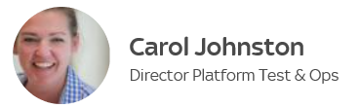
Why did I apply?
1
PDP conversations were always where do you see yourself in the future?
I always want to continually progress my career and knowledge within Sky but never really knew in which direction.
Back in September 2018 I had seen the ad for the GIT course and was thinking about applying, then I attended a Working Lunch invite from Carol from UKIS.
There was a large group of women attended from Sky, the majority I didn’t know at all and this was the first time I’d met or spoken to Carol.
Her can do attitude around promoting and encouraging people to get into Tech no matter what you're level of knowledge or abilities were was really evident,
and after I attended it made up my mind to go for it!

Slide 4
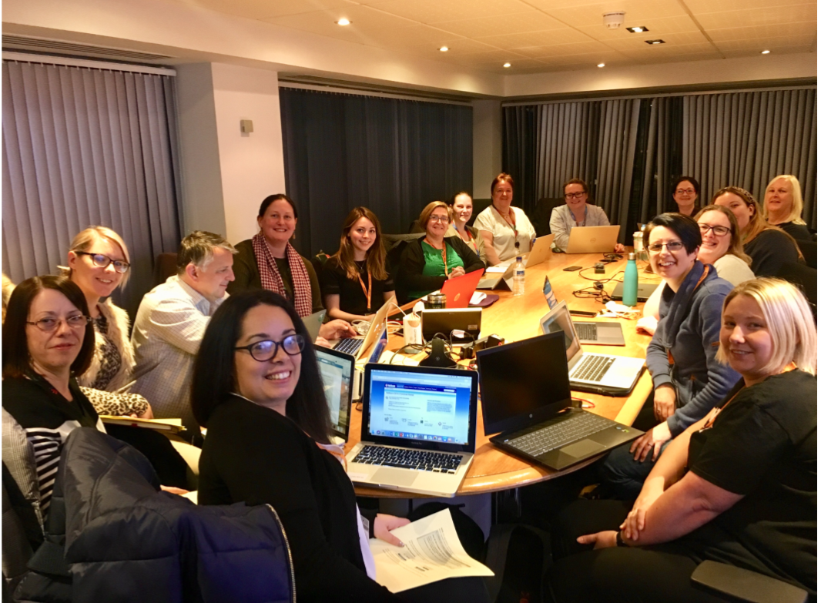
2
2
The Get into tech group
Out of 86 Applicants 14 places were given
14 women
7 internal
7 external

Slide 5


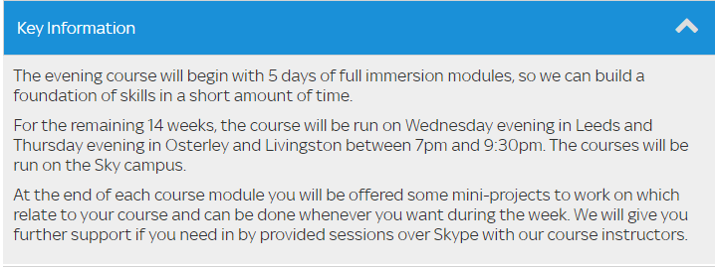
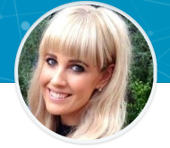
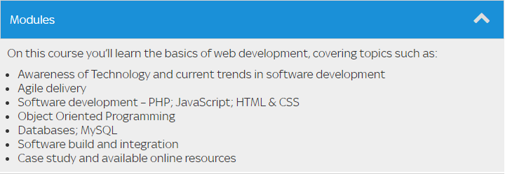
2
3
Jennifer Standish– Software Engineering Academy Manager
Co-ordinating Get into Tech courses for women. Promoting, attending and hosting relevant Women in Technology events.

Slide 6
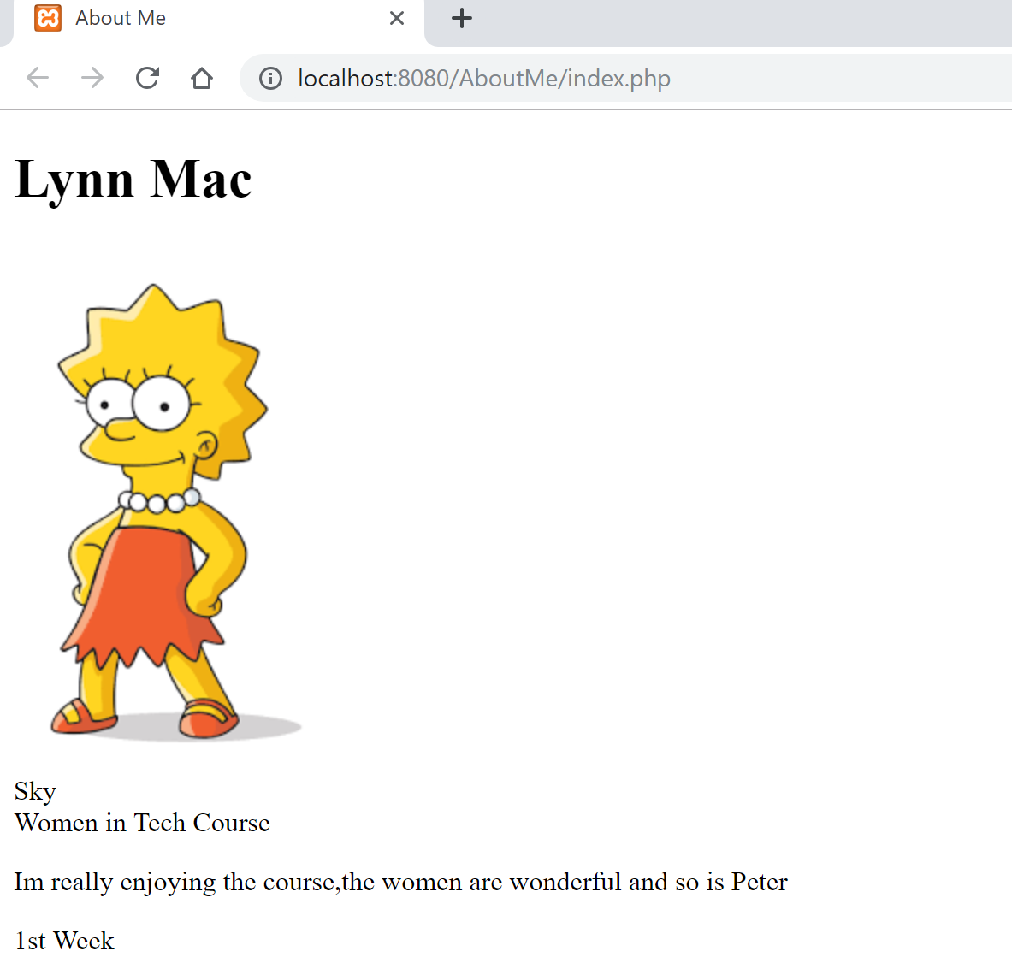
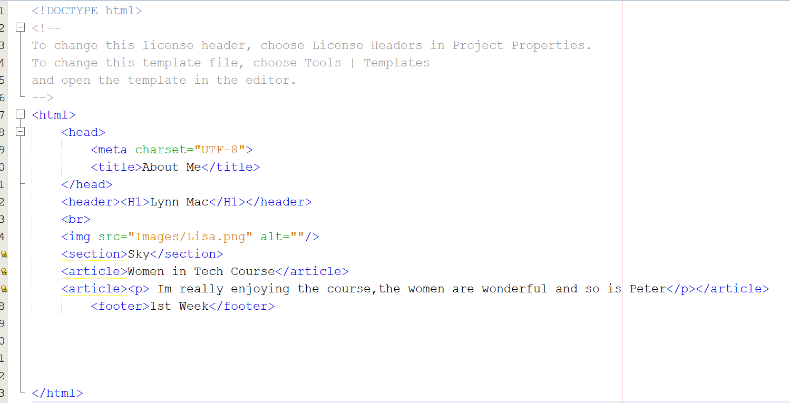
2
4
So far
Learning to create a simple html page.
http://localhost:8080/AboutMe/index.php
Below is the code for the page on the right using
HTML code which takes you to a local web browser.

Slide 7
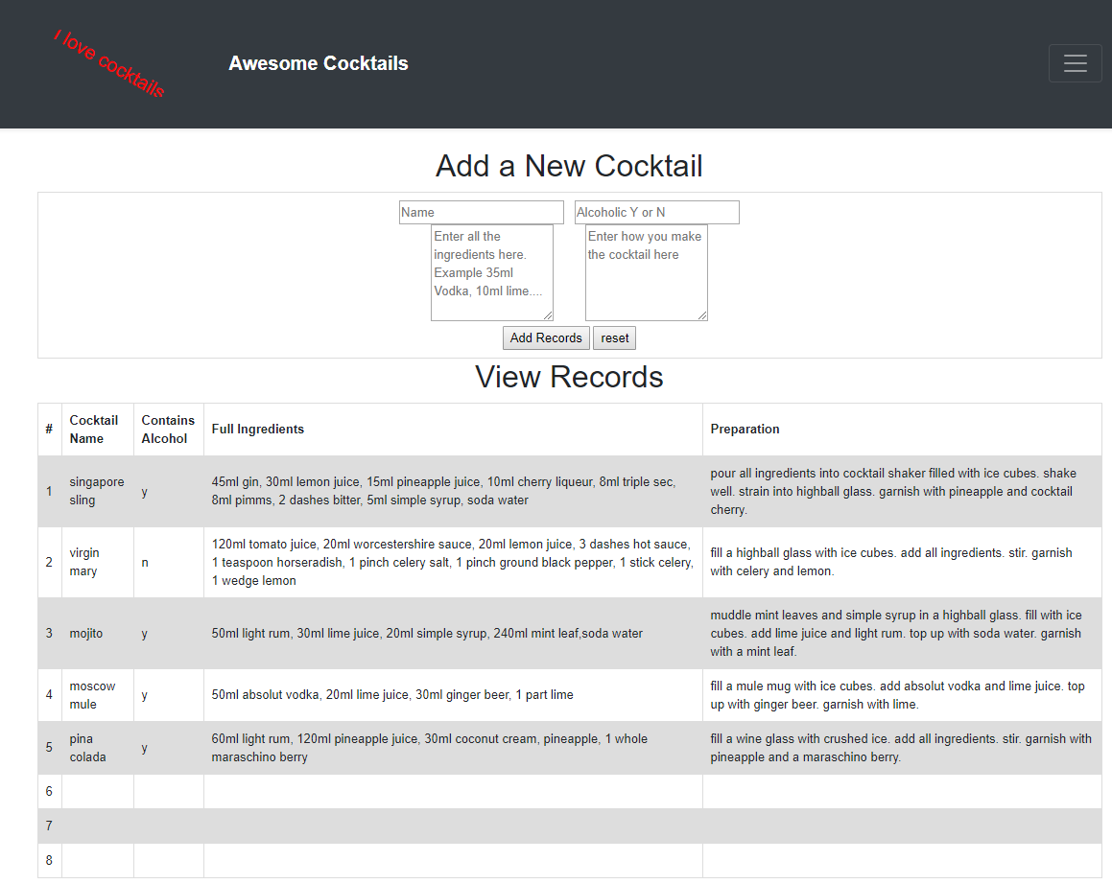
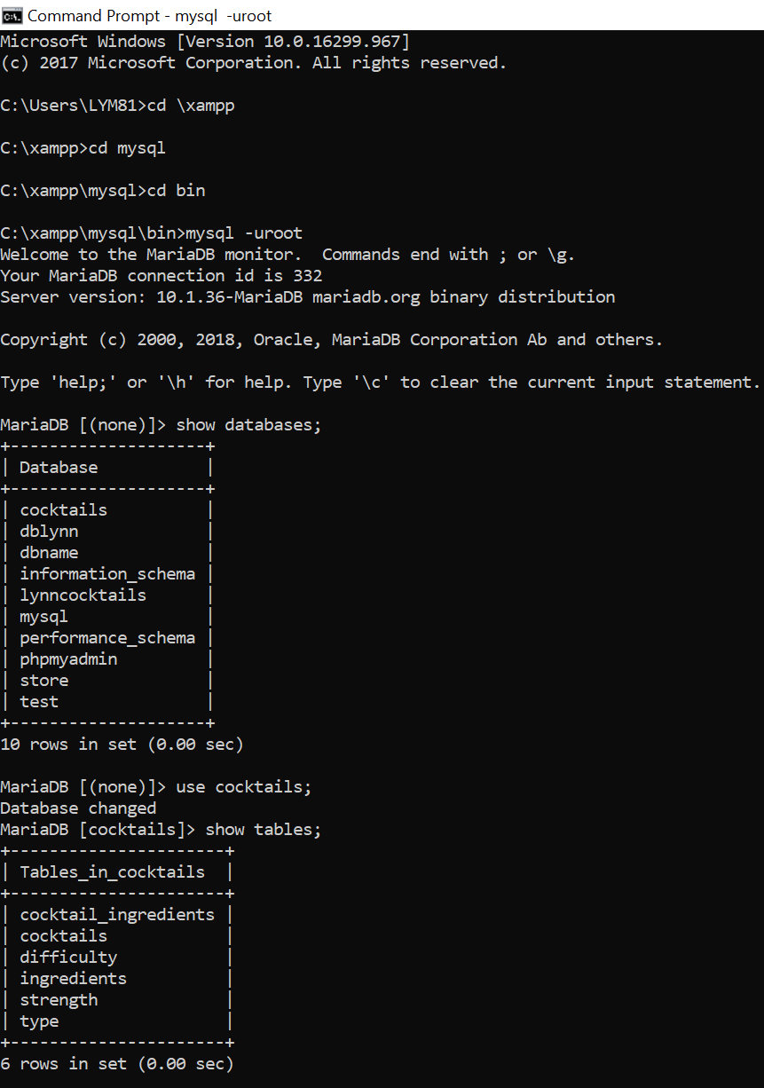
2
4
So far…………. continued
Built my first Database and its related webpage

Slide 8
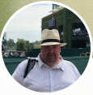
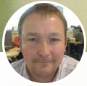
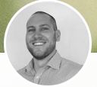
Department Support
5
Roye Peters- Reporting Manager, DTO Dev and Ops
Roye has supported me when I was creating a new database
and couldn’t get my head round getting my tables accurate.
Graham Murray– Senior Data Platform Engineer, DTO Operations
Graham has been my wing man and has always been a font of knowledge for PHP, PDO, MY SQL etc.
Scott Riddell – Head of Platform Engineering
Supported me from day one of knowing I’d been accepted onto the course and is making sure I get the development need.
The above 3 people have been my biggest support in the department and wanted to give them a shout out!
Graham and Roye thanks for being so patient and sharing just a small part of you’re knowledge.
“A good leader who sets out to help employees to believe in themselves, in their ability to perform well, sets the stage for their possibility to succeed. The confidence that results from employees' high personal expectations in turn spurs them to higher achievement and productivity – their performance rises to the level of their own expectations.”
A great quote from Bruna Martinuzzi’s book: "The Leader as a Mensch: Become the Kind of Person Others Want to Follow.

Slide 9
2
6
What's next?
Job shadowing
Secondment
New Online courses
Review and revisit course exercises
Keep practicing coding
Assist with work in the department
Learn different coding languages
Utilising knowledge within my own team
Continue to practice building Web applications
Keen to expand basic GCP and Tableau knowledge

Slide 10





Sky Software Engineering Academy
7
Attraction and Selection
(Coding Test and Assessment Day)
5 weeks boot camp
In Leeds or Osterley
4 months Educational projects
2 months Delivery team placement
Post Placement
Forefront of digital innovation as you start building your career
Agile delivery, cutting edge technology, TDD, CBI, real scrum team experience
Support from our Senior Software Engineering professionals
Evolve people into Software Engineers which are a good fit for our business

